Slide 1
Exxelia’s Path to RoHS: Ensuring Reliability in Next-Generation Space capacitors
6TH SPACE PASSIVE COMPONENT DAYS 2026 - ESA/ESTEC
Noordwijk, The Netherlands 13-16 October 2026
Redouane HAMMAL
GBU Capacitors
Exxelia SAS, 105 Rue Géneral Leclerc, 67440, Marmoutier, France
Email : redouane.hammal@exxelia.com

Slide 2

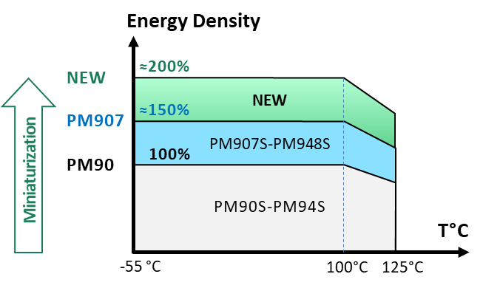
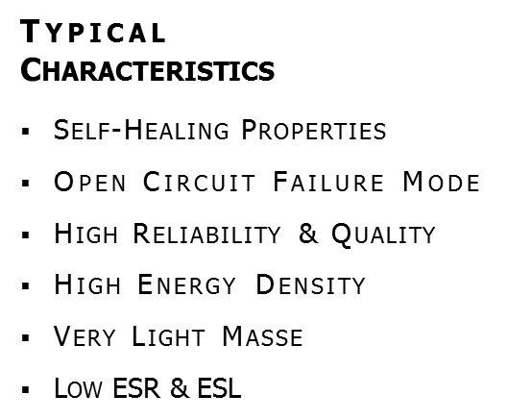
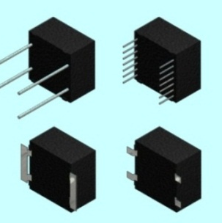
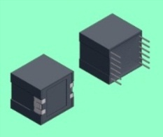
Exxelia Film Capacitors – PET technology for Space
Exxelia Background in PET Technology
Continuous Design Improvement for Better Miniaturization & Integration Behavior
1990
1994
2007
2008
2008 - 2009
2009 - 2012
2013 - 2016
2026 - 2027
Development of
PM90 - PM94
ESA Eval-Qualif
New Series
PM907 - PM948
Miniaturization
Exxelia
Internal Qualif
PM907 - PM948
CNES
ESCC Evaluation
PM907S - PM948S
ESA
Eval & Qualif
PM907S - PM948S
ESA
New Project
PM907S - PM948S
5 years Testing allowing Proven Reliability Data & Technological Behaviors
The goal of the New Project
Lead Free Transition (RoHS reflow process)
Miniaturization –> Higher Energy Density
Thermal modeling Comsol
Notes:
Increase Awareness by innovation (vieilles familles, dernier lancement 1997)
Secure Existing Business (100K€ à risque attaqué par concurrence + 300K€ de legacy business à risque si re-design)
Diversify our Markets (Thruster + Cruise + Indus + Filtering)
Gain Market Share (addresser les marchés où nous ne sommes pas implantés US/Brésil/Corée)
Amortize the New Production Line “MBSAU”

Slide 3
Project objectives
Objectives:
  Improve temperature capability of SMD metallized PET capacitors for lead-free transition, preserving space-grade lifetime and reliability
  Increase energy density
How to achieve those objectives:
Objectve 1:
  1/ Capacitors:
    Improve the process for better temperature resistance of capacitors
    Simulate the temperature distribution inside the capacitor by Comsol simulation
    Optimize the surface treatment of terminals
  2/ PCB assembly:
    Optimize soldering parameters (temperature cycle)
    Selection of suitable RoHS alloys
    Others: PCB (layer thickness, coating)
Objective 2:
  Scan the full product range and identify capacitance / voltage values where an increase of voltage stress is possible

Slide 4
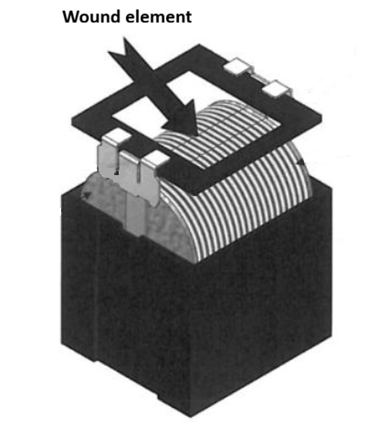
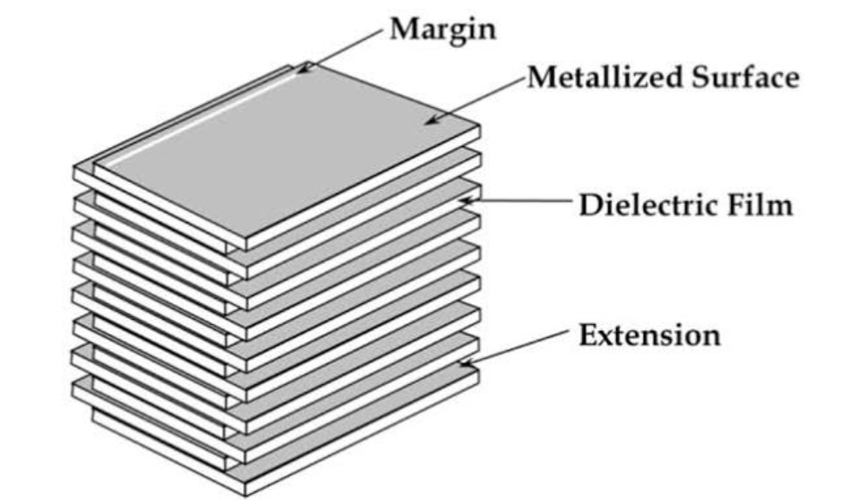
Can standard SMD film capacitors be processed as RoHS compliant?
Dielectrics | Technology | Capacitance Range | Voltage Range (V_{DC}) | Re-flow soldering T_{max}°C
PET | Wound/Box encapsulated | 0.01µF – 6.8 µF | 63 V – 1000 V | 220° - 250°
PPS |  | 0.01µF – 2.2 µF |  | 250°
PEN | Stacked/Bare | 0.001µF – 4.7 µF | 25 V - 1000 V | 240° - 255°
PPS |  | 1nF – 0.22 µF | 16 V – 50 V | 250° - 260°
PET |  | 10nF – 4.7 uF | 63 V – 630 V | 240° - 245°
Benchmark of commercial SMD film capacitor offerings :
Dielectric films (PET, PEN, PPS).
Technologies (stacked vs. wound) and (Encapsulated vs. Bare)
Commercial offerings mainly focus on lower capacitance ranges.
Our range:
50V to 1250 V
10nF to 200µF
Stacked vs.wound

Slide 5
Which dielectric is the best candidate ?
Property | PP (Standard) | PPHT | PET (Standard) | PEN | PPS
Relative Permittivity | 2,2 | 2,2 | 3,2 | 3 | 3
Breakdown | 600 V/µm | 700 V/µm | 350 V/µm | 300 V/µm | 350 V/µm
Operating voltage stress | 200-250 V/µm | 200-250 V/µm | 125 V/µm | 100 V/µm | 80 V/µm
Melting point Temperature | 168°C | 173°C | 255°C | 265°C | 285°C
Max operating Temperature | 105°C | 140°C | 125°C | 150°C | 180°C
Self-Healing | Excellent | Excellent | Good | Moderate | Poor
Min, Thickness (µm) | 2,2 | 1,9 | 0,9 | 1,4 | 1,2
Dissipation Factor (ESR) | Very Low | Very Low | High | Moderate | Low
Conclusion | (-) : Melting point too low for reflow. Low permittivity prevents miniaturization. REJECTED | (-) : Melting point too low for reflow. Low permittivity prevents miniaturization. REJECTED | (-) : Melting point and Max temperature low for lead-free reflow. CANDIDATE | (-) : Limits high-gradient designs. CANDIDATE | (-) Poor self-healing; limits miniaturization. REJECTED
PET and PEN => best candidates
Selection based on the optimal compromise between temperature resistance and dielectric thickness.

Slide 6
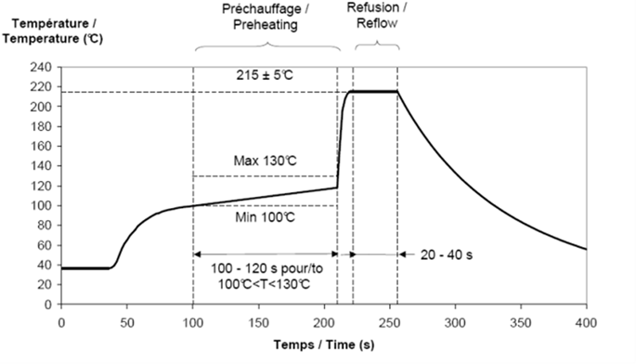
Example of non RoHS reflow profile
Challenges for RoHS
compliant process:
RoHS solder allows need higher temperature
Heat should not damage the dielectric
Reflow Soldering Optimization
Adapting standard reflow recommendations to high-reliability space constraints.
Process Control (3 Phases):
  Pre-heating: Safe temperature rise to avoid thermal stress.
  Soldering: Optimized peak T_{max} and time to protect the component.
  Cooling: Gradual cool-down to prevent micro-cracks.
Reliability: Temperature tracking (no overshoot) and optimized internal heat treatments.

Slide 7
Critical technical challenges
Critical Technical Challenges
Thermal Gap (+30°C):
Reflow peak reaches 245°C–250°C, inducing severe thermal stress on the metallized PET dielectric film.
IMC Growth:
Accelerated Intermetallic Compound formation at higher lead-free temperatures, impacting joint integrity.
Process window narrowing:
Balancing optimal wetting with voiding control to prevent mechanical failure
under launch vibrations.

Slide 8
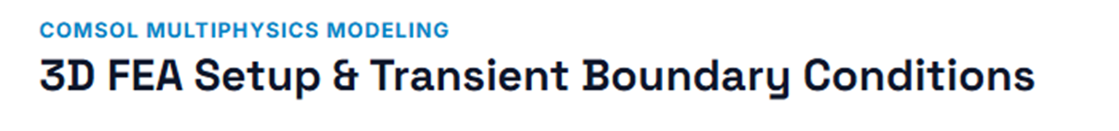
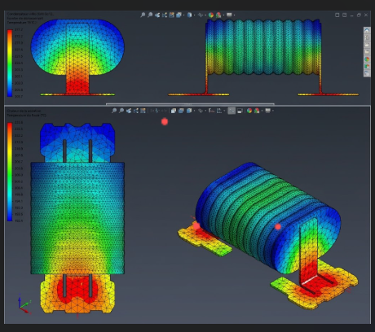
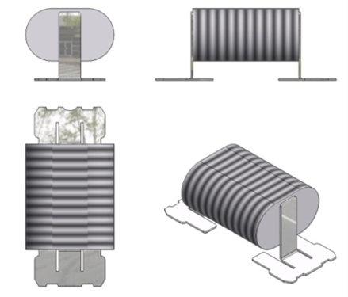
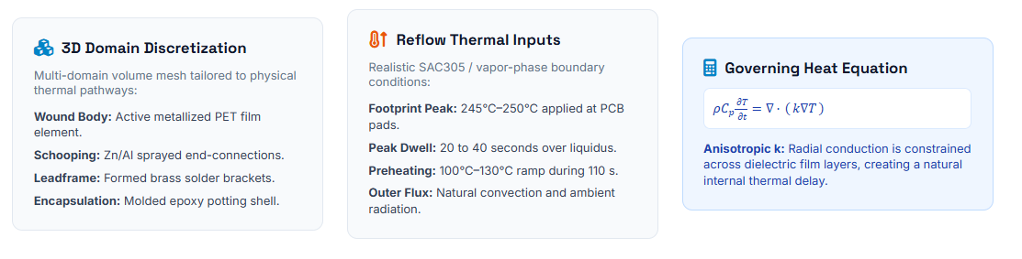
Simulation

Slide 9

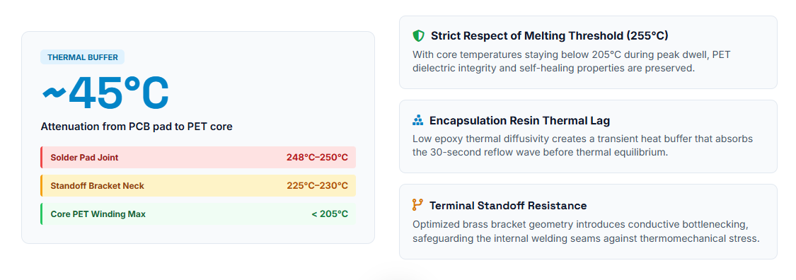
Simulation

Slide 10
Scope of the work
Test vehicles to be manufactured
Scope of the work
  Exxelia PM series (PET dielectric for space applications).
  SMD variants suitable for reflow soldering.
Reference | Capacitance (µF) | Voltage(Vdc)
Ref1 0.82µF 400V | 0.82 | 400
Ref3 10µF 250V | 10 | 250
Ref2 15µF 63V | 15 | 63
Ref4 1,2µF 630V | 1,2 | 630
Ref4 10µF 50V | 10 | 50
Ref4 12µF 170V | 12 | 170
Group 1: PCB Soldering Cycle
Solder parameters definition
Thermal cycling, step-stress & endurance
Group 2: Validation of Settings
Temp cycling | vibration testing
Step-stress | endurance
Group 3: Miniaturization (Higher Voltage)
Voltage step-stress | temp step-stress
Temp cycling | endurance

Slide 11
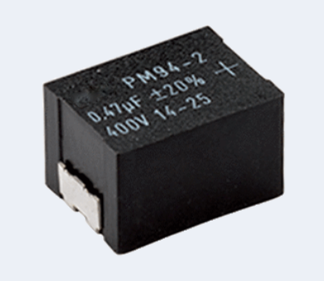
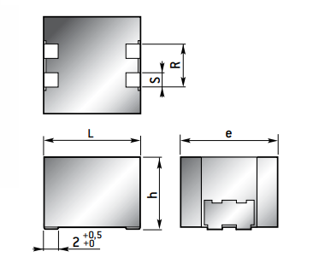
Miniaturization
Rated voltage (Vdc) | Optimized voltage stress | Possibility to increase voltage stress
63 | No | No thinner gauge
100 / 170 | Almost | Too high stress with thinner gauge
250 | No | Too high stress with thinner gauge
from 400 V to 1250 V | No | Yes
Expected energy density increase: between +10 and +40%
Reference | Capacitance (µF) | Voltage (Vdc) | Current dimension (mm) | New dimension (mm) | Energy density increase (%)
PM907 | 3.9 | 630 | 31x22x32 | 31x12.5x32 | 40%
PM948S | 1,2 | 630 | 18.5x17x17 | 18.5x15x17 | 12%

Slide 12

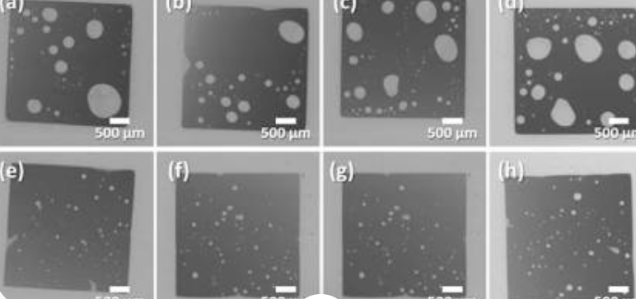
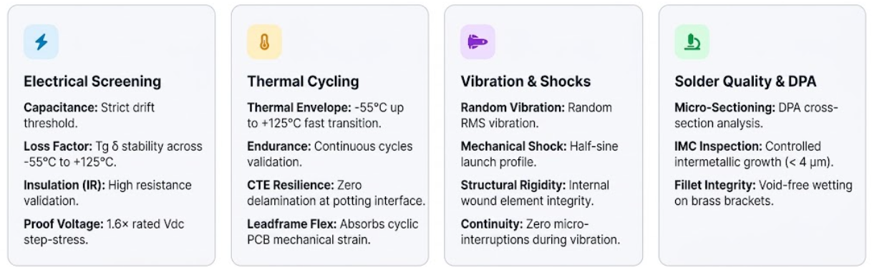
Evaluation tests and analysis
Solder quality check by DPA

Slide 13
Thank you for your attention
Questions & Answers
Redouane HAMMAL
GBU Capacitors
Exxelia SAS, 105 Rue Géneral Leclerc, 67440, Marmoutier, France
Email : redouane.hammal@exxelia.com

Slide 14
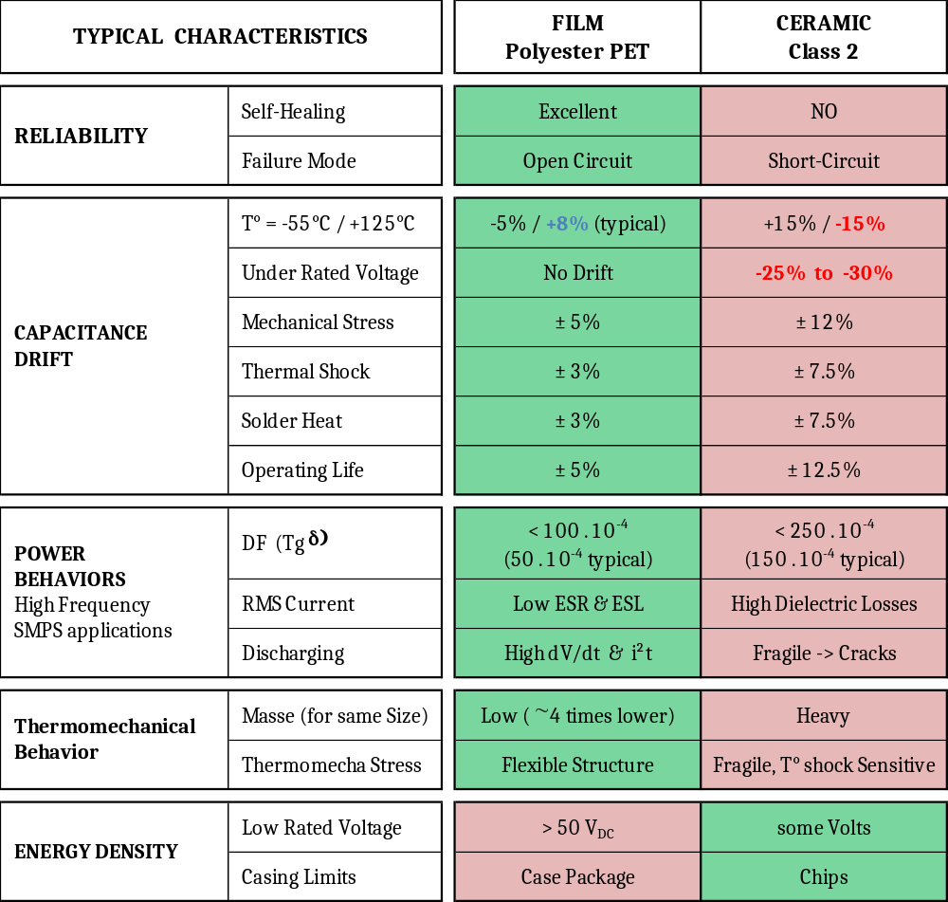
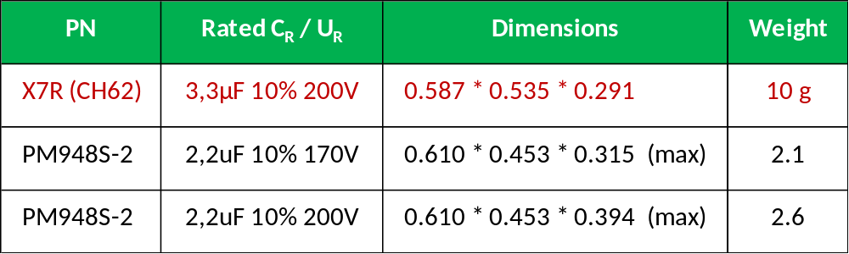
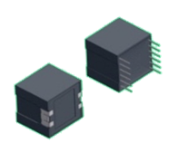
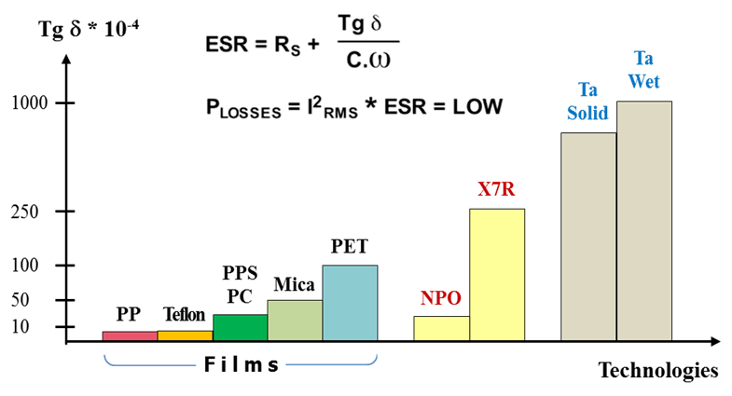
Advantages of PET Technology
Example of Comparison
C_{PET} ~ 60-70% C_{X7R}
Better Power Behaviors
Even Lower Energy Density

